Slide 1
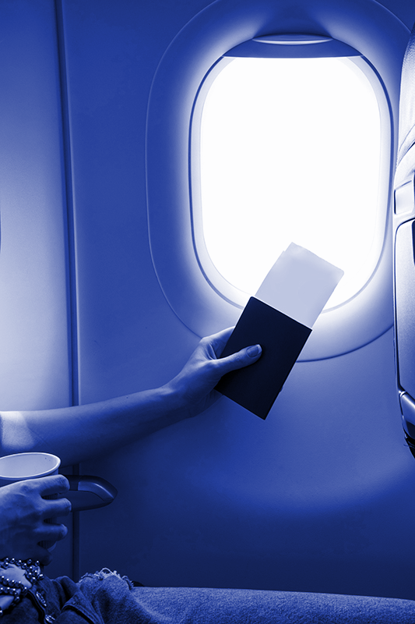
Aircrux
CS207 – ADP Project
Notes:
1. Table of contents
2. About us
3. Our history
4. Our philosophy
5. Quote
6. Locations
7. Our services
8. Best sellers
9. Our strengths
10. Customer profile
11. Our numbers
12. Our growth
13. Future projects
14. Customer testimonials
15. Awards
16. Our team

Slide 2
Details
Group No – 13
Members :
B20153 – Girish Geadhar
B20154 – Gurkanwal Singh
B20157 – Md Arif
B20161 – Parth Joshi
B20164 – Prateek Raj
B20166 – Ridam Nama
TA Mentor – Rajat Bansal
Mentors
Dr. Varun Dutt
Dr. Dinesh Singh

Slide 3
Table of contents
01
02
03
04
introduction
Technology
Explaining the main content of the project.
The methods used in the implementation.
Process
Summary
Describing the whole working of the webpage.
Conclusion of the entire project.

Slide 4

Introduction
We have created a flight ticket booking webpage using web technologies like HTML, CSS, JavaScript. The backend part has been implemented using PHP and database are been implemented using SQL.
The main work of the website is to book flight ticket by filling details of arrival and departure airport and details like date, time and class.
We can also see our booked flights and its details.

Slide 5

Technology
HTML – It is providing the skeletal structure for the webpage. It is like a blue-print of the website.
CSS – Styling of the webpage like font, colours, padding etc.
JavaScript – It is integrating the frontend with the backend codes.
PHP – It is used to connect with the database and making the webpage dynamic and interactive.
SQL – Used for database handling.

Slide 6
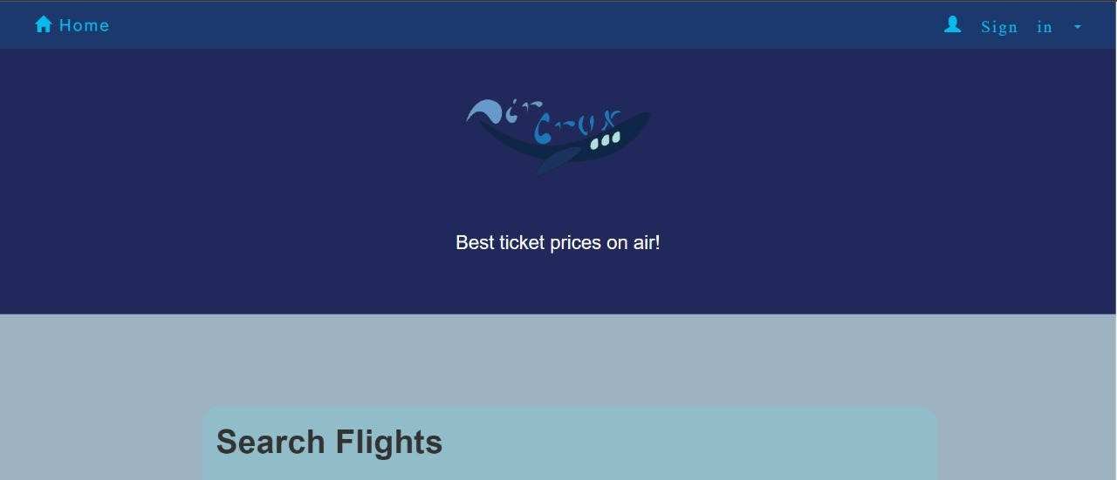
Our website

Slide 7
Process

Slide 8
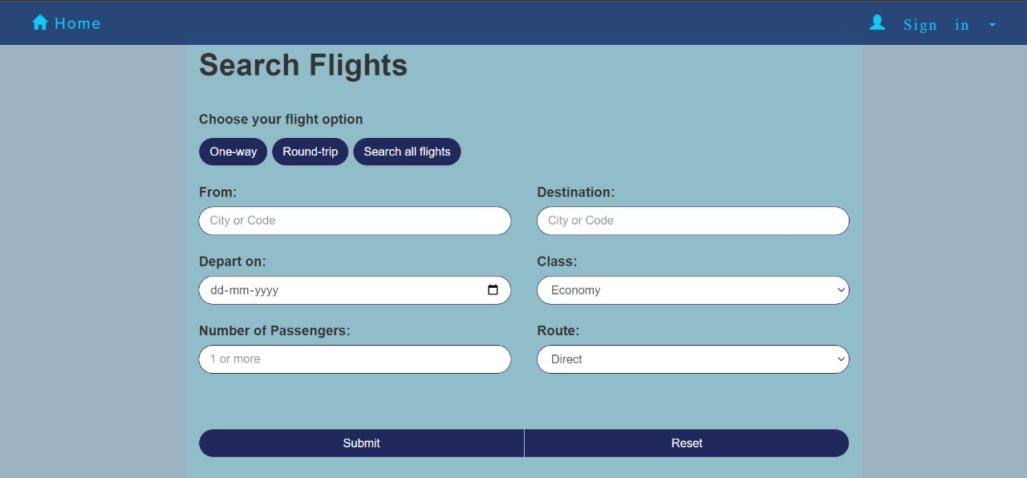
Search flights

Slide 9
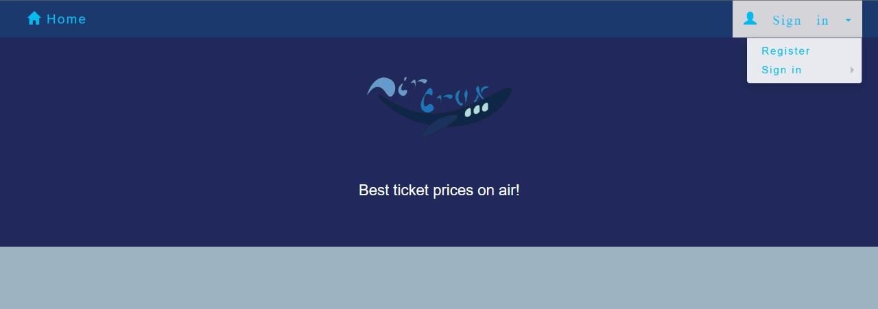
Sign-in

Slide 10
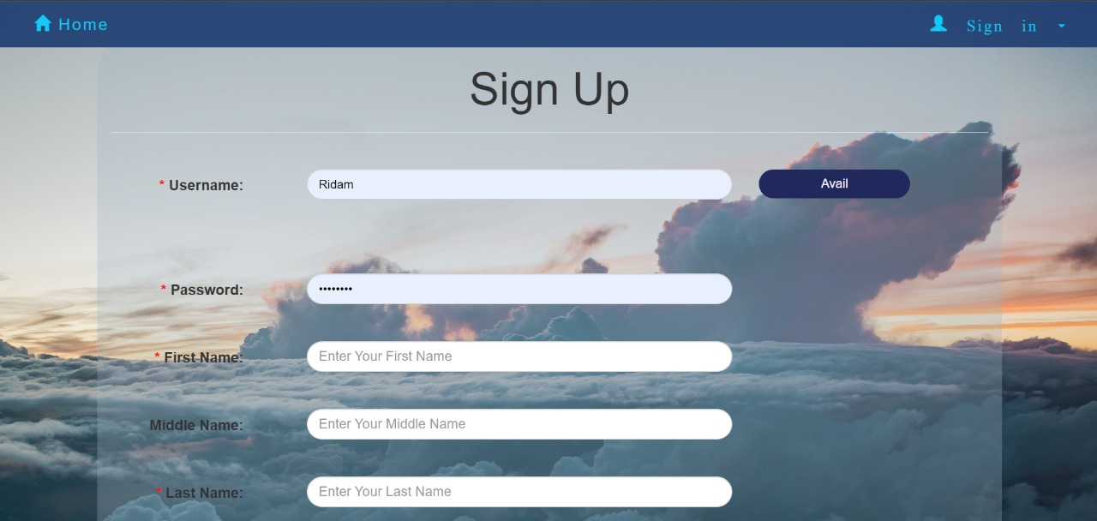
Register

Slide 11
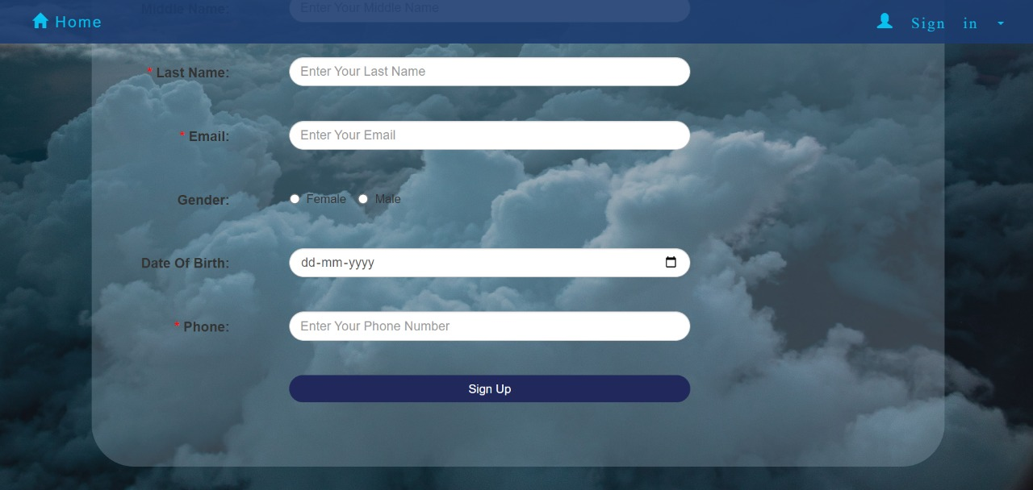
Register

Slide 12
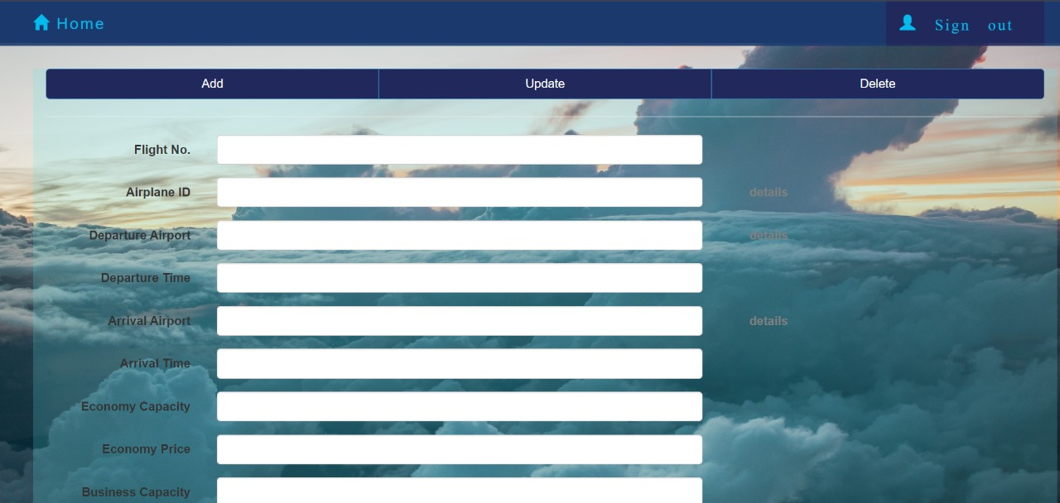
Admin controls

Slide 13
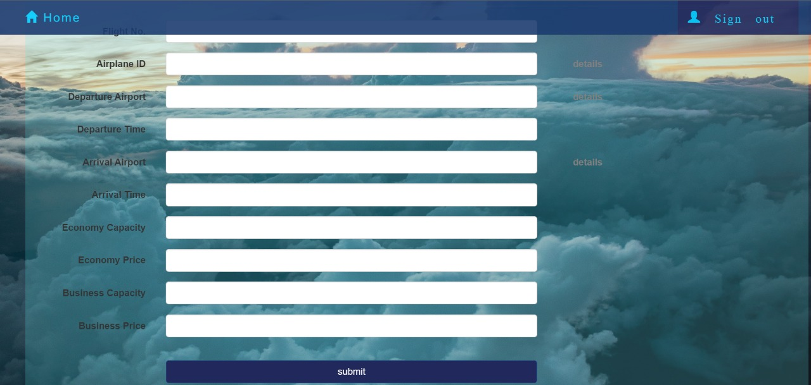
Admin controls

Slide 14
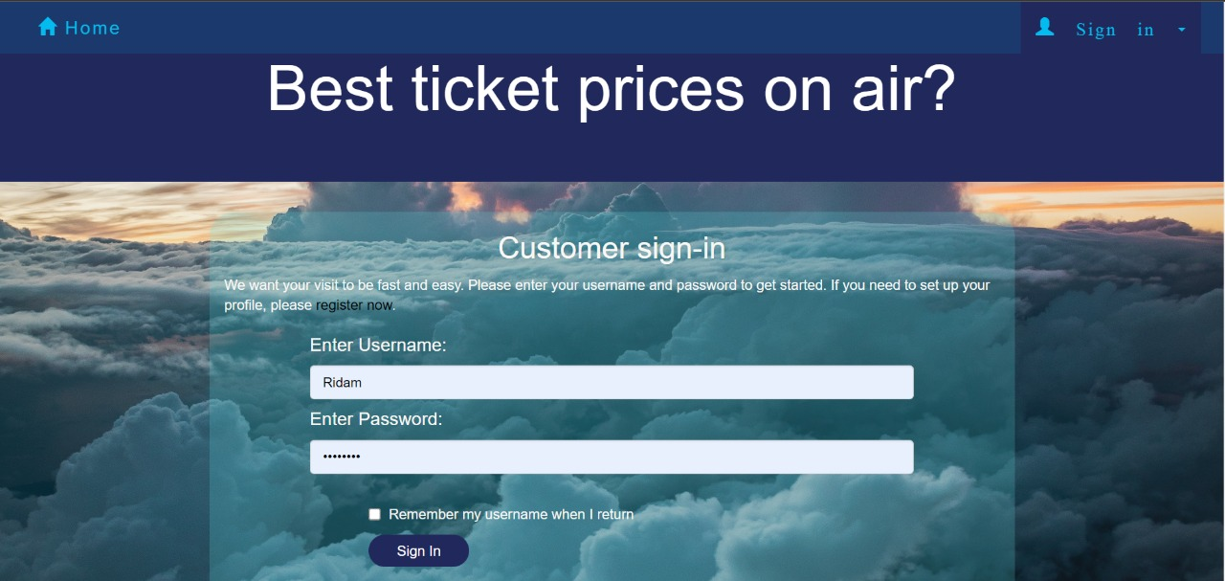
Customer sign-in page

Slide 15
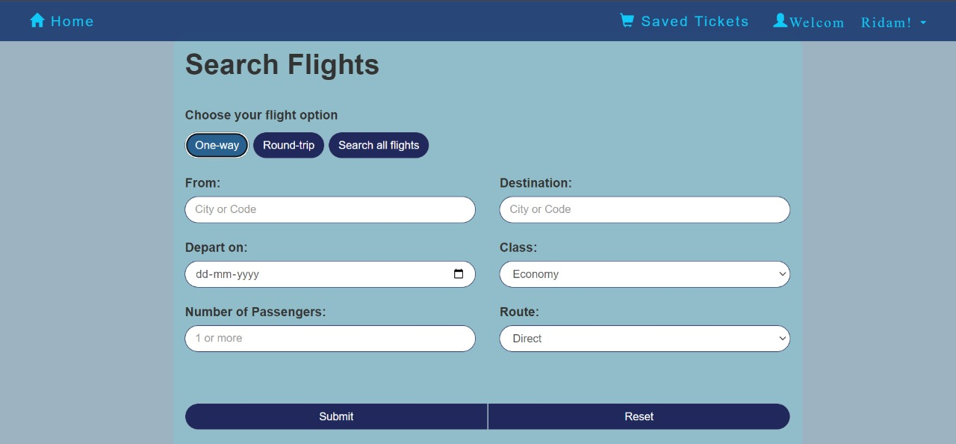
Customer signed-in

Slide 16
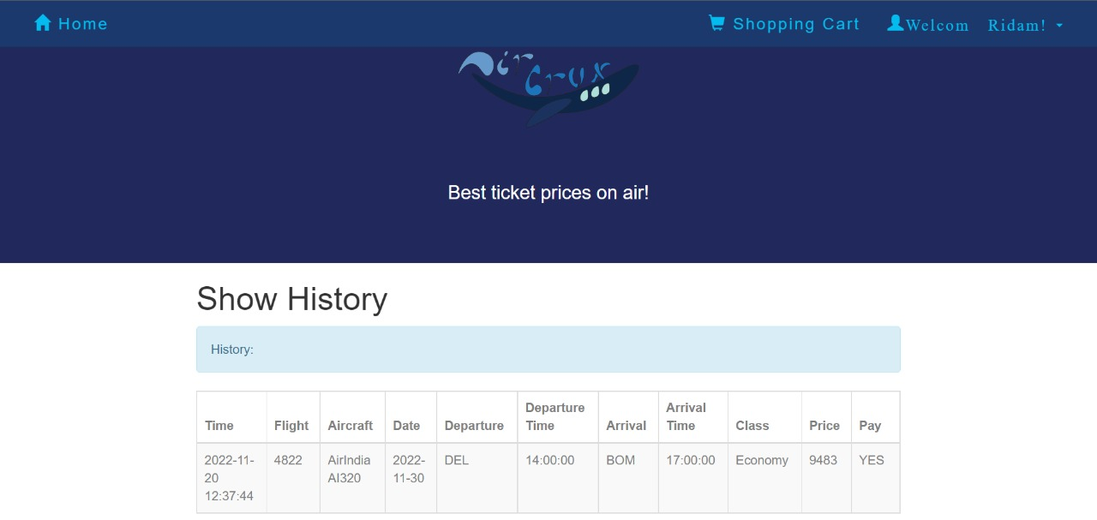
History

Slide 17
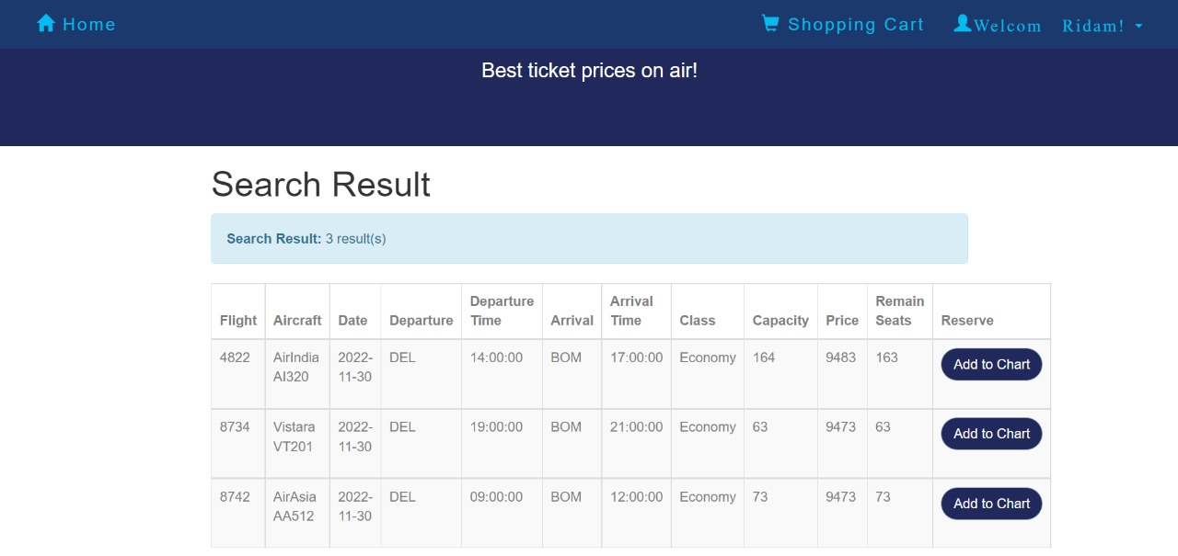
Searched history for one way

Slide 18
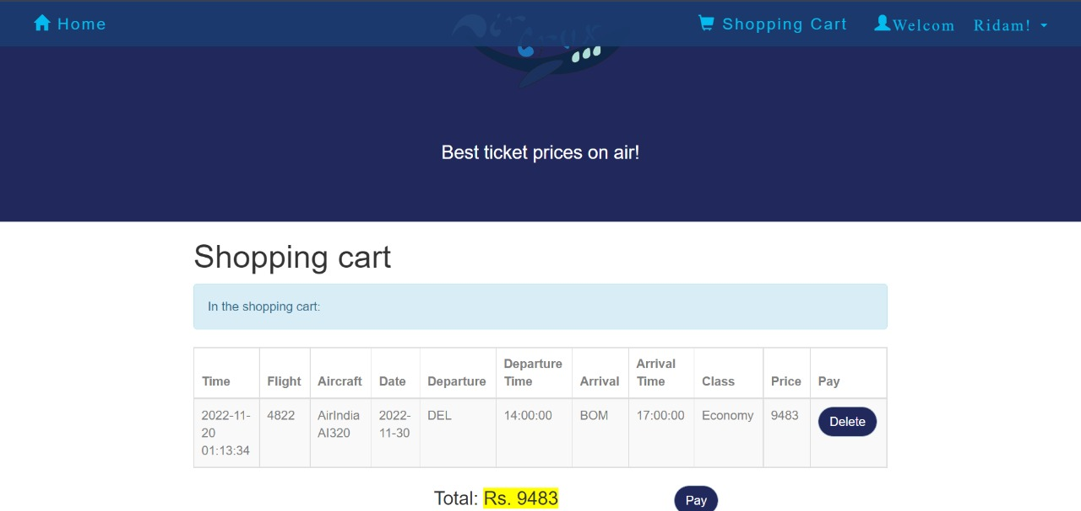
Shopping cart

Slide 19
Summary
Throughout the course of making the project , the whole group got the chance to touch upon their knowledge about working in a group project and using various technologies.
We were able to successfully create and implement a working website which can be used in industrial field for booking and buying airplane tickets.
We used a culmination of html, CSS, JavaScript, php and SQL for the entirety of the project. We also used the illustrator to create the Aircrux logo.

Slide 20
Thank you!!!

